Slide 1
Research Data

Slide 2
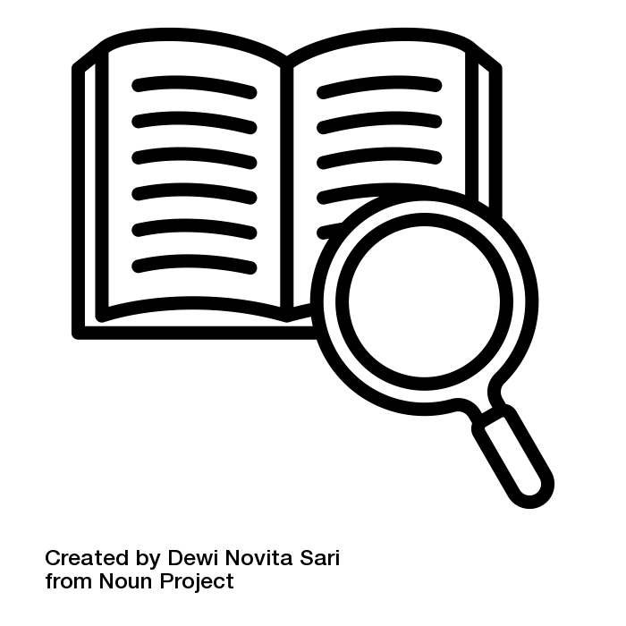
What is Research Data?
Research Data is generated during scientific work (e.g. through measurements, surveys, source work) and is the basis of scientific work and document its results. [forschungsdaten.info]
Nevertheless, there are different definitions depending on:
Discipline
Research Funders
Notes:
Slide content:
Research data includes measurement data, laboratory values, audiovisual information, texts, survey data, objects from collections or samples that are created, developed or analysed in the course of scientific work.
There is not the one and only definition of what research data is: different disciplines, different research funders, sometime even different teams at the same university can have slightly different definitions of, what research data is.
For example, methodological test procedures such as questionnaires, software and simulations can also represent key results of scientific research and should therefore also be categorised as research data.

Slide 3
Distinction between terms
Term | Key Question | Definition | Example
Data Type | What is this single value technically? | Smallest unit: classification of an individual data point | 15.5 → Float (soil moisture) "Winter Wheat" → String
Data Format | How are the values structured? | Schema or standard used to organize & exchange data | ISO 8601 date standard YYYY-MM-DD, xml
File Type | What kind of file is this? | General category based on content or purpose | Raster data (drone image), table (yield data), vector data (field boundaries)
File Format | How is the file technically stored? | Specific encoding on disk (= file extension) | .csv, .GeoTIFF, .shp, .xlsx
<Foliennummer>
Notes:
Slide content:
Think of them as a hierarchy: Data Types are the atoms; Data Formats are the molecules (structure); File Types are the general category of the object; and File Formats are the specific box the object is stored in.
1. Data Types
Definition: This refers to the most basic classification/interpretation of a specific piece of value. It tells a computer system how to interpret a single cell or a single reading. This is usually defined at the programming or database level.
Agricultural Examples:
Integer: Whole numbers used for counting. Example: 150 (The number of cattle in a pen).
Float (Floating Point): Numbers with decimals, used for precision measurements. Example: 6.54 (Soil pH level) or 22.5 (Temperature in Celsius).
String (Text): Characters or words. Example: "Winter Wheat" (Crop variety) or "Field_North_01" (ID).
Boolean: A binary True/False value. Example: TRUE (Is the irrigation valve open?) or FALSE (Is the silo full?).
Date/Time. Example: Sowing date, Harvesting date
2. Data Formats
Definition: This refers to the structure, schema, or standard used to organize the data types so they make sense logically. It is how the data is arranged before it is saved into a file, or how it travels over a wire (like a cable between a tractor and an implement).
The Question it answers: "How is the information structured or standardized?"
Agricultural Examples:
ISOBUS (ISO 11783): This is the gold standard data format for communication between tractors and implements (like sprayers). It dictates the specific syntax of how the tractor tells the sprayer to turn on.
Date Standards (ISO 8601): Deciding to structure a harvest date as YYYY-MM-DD (2023-10-25) rather than MM-DD-YY (10-25-23).
JSON Schema for Weather: Arranging weather sensor data in a specific hierarchy, e.g., { "station": "A", "readings": { "temp": 20 } }.
3. File Types
Definition: This is a high-level classification of what "kind" of file you are dealing with based on its content or purpose. It is a general category, not the technical encoding.
The Question it answers: "Is this a picture, a map, or a spreadsheet?"
Agricultural Examples:
Raster Data (Image): A grid of pixels representing aerial drone imagery or satellite NDVI scans.
Vector Data (Geospatial): Lines and polygons representing field boundaries or drainage tile lines.
Tabular Data: Rows and columns representing yield monitor logs or soil sample results.
Unstructured Text: A PDF report from an agronomist or field notes.
4. File Formats
Definition: This is the specific technical encoding used to store the data on a hard drive. It is almost always indicated by the file extension (the letters after the dot). It dictates which software can open the file.
The Question it answers: "How are the bits encoded? Is it a .csv or a .xlsx?"
Agricultural Examples:
For Raster Data:
GeoTIFF (.tif): A standard image format that includes embedded GPS metadata (crucial for yield maps).
JPG (.jpg): A compressed image used for general crop scouting photos (usually loses the GPS precision).
For Vector Data:
Shapefile (.shp): The industry standard for field boundaries (invented by ESRI).
KML (.kml): The format used if you want to view your field boundaries in Google Earth.
For Tabular Data:
CSV (.csv): A simple text file where soil sample results are separated by commas.
XLSX (.xlsx): A Microsoft Excel workbook containing formulas and charts regarding farm finances.

Slide 4
So many “types” of data…
Data status: describes the processing status of data
Examples: raw data, processed data, aggregated data, …
Data origin: where does the data comes from?
Examples: primary data, secondary data
Data category: research data type / data domain
Examples: time series data, genetic data, phenotypic data, sensor data, satellite data, drone data, legacy data, …
<Foliennummer>
Notes:
Slide content:
In addition, there are many different ways to further classify the term ‘data’, whereby different data types are often referred to – this term is frequently used in different contexts in different ways and is not particularly precise. Here we show some forms of classification of ‘data’ in which the term data type can occur without referring to the definition shown in the previous slide.
Data status: Processing status of data ->This is not a question of data type, but rather a question of data status.
Raw data
Directly from measurement or observation
Unchanged
E.g. raw signal from a soil moisture sensor
Processed data
cleaned, calibrated, filtered
e.g. temperature-corrected soil moisture values
Aggregated data
summarised (averages, totals)
e.g. daily average temperature from 10-minute measurements
Data origin (or data source): This refers to the data source, not the data type.
Primary data
Collected independently
e.g. own field trials
Secondary data
Taken from existing data sources and used for something, it wasn’t originally created for
e.g. weather data from the German Weather Service
Data category: Here we are at the level of data type or data domain.
Time series data
Time-related measurements
e.g. hourly stable temperature
Genetic data
DNA sequences, SNP data
often high-dimensional matrices
Phenotypic data
Observable characteristics
e.g. plant height, grain yield
Sensor data
Continuous technical measurement data
e.g. NIR sensor, soil moisture
Drone data
Image or multispectral data
often raster files

Slide 5
Research Data Management

Slide 6
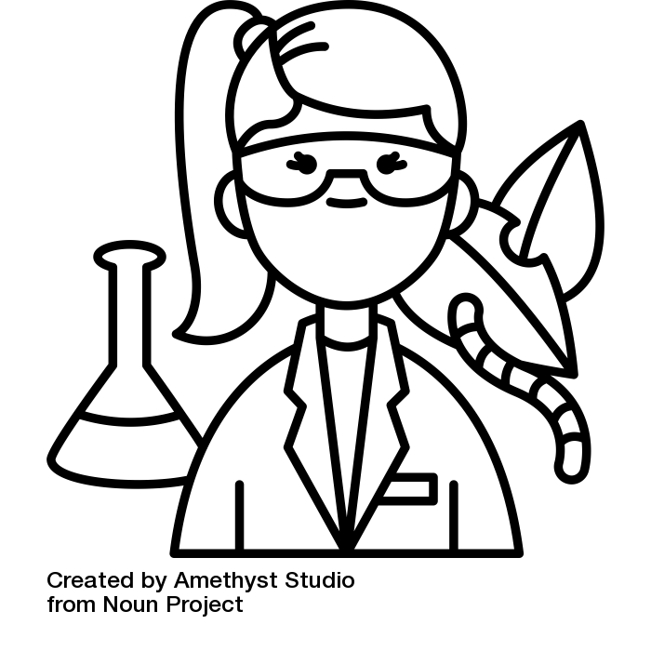
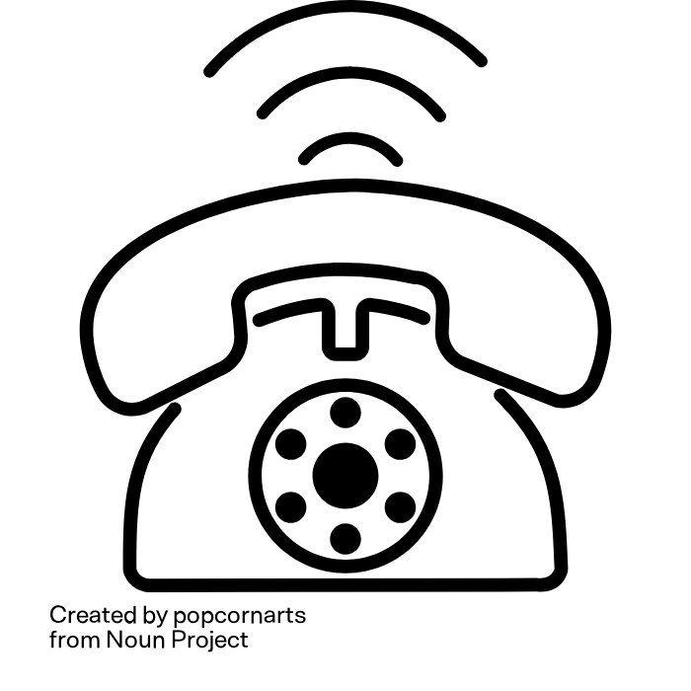
Thought experiment
This is Lena.
She is an agricultural scientist
Lena is calling you!
She wants some of your data
Illustration: “telephone“” by popcornart and “biologist“” by Amethyst Studio are licensed under CC BY 3.0
Notes:
Slide content:
Think of a data set that you haven't actively worked with for at least a year....
and now: let's do a little thought experiment
If you like, you can close your eyes
Imagine you're sitting comfortably at your desk when the phone rings. It's Lena, a young, highly motivated agricultural scientist.
She says she has learnt that you have data that would help her enormously to advance her research project.
The data Lena is referring to is the data that you haven't actively worked with for at least a year.
As you find Lena's research project very worthy of support and have already completed all publications based on this data, you would like to make your data available to Lena.

Slide 7
Thought experiment
Who can find the data Lena is looking for in two minutes?
Will Lena be able to open the data?
Will she be able to understand the data?
  and you, do you still understand your own data?
Illustration: “biologist“” by Amethyst Studio from noun project is licensed under CC BY 3.0
Notes:
Slide content:
Ask the participants to rise their (digital) hand or stand up if they think that
they can find the desired data for Lena within 2 minutes?
Lena will be able to open the data?
Lena will be able to understand the data?

Slide 8

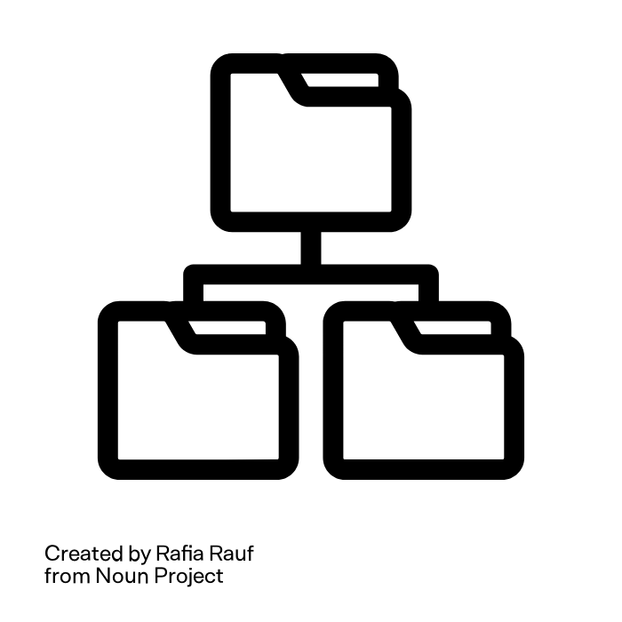
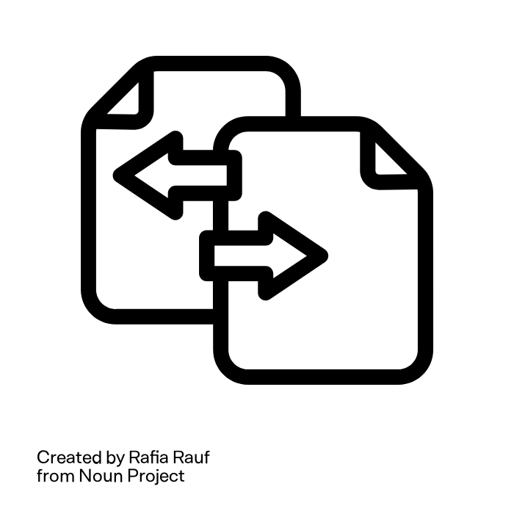


What does Lena need to be able to use the data?
Data-
organisation
Inter-
operability
Docu-
mentation
Backup
Metadata
She needs good Research Data Management
Illustration: “File Edit”“, “File Transfer”“, “File Tag”“, “Folder Backup”“ and “Folder Structure”“ by Rafia Rauf from noun project are licensed under CC BY 3.0
Notes:
Slide content:
This slide shows, what it takes for Lena (or anyone else, including your future self) to be able to reuse the data:
Data is still available - backup
Data can be found - good data organisation
Data can be opened - interoperability - open format
Data interoperability = ability of a data set to work together with other data sets or systems without any special effort for the user
Lena knows whether the data is realy suitable for her project - metadata
Lena knows how the data was collected and processed, she understands what the abbreviations mean - data documentation
All of this are central aspects of a proper RDM
Research data management (RDM) = a set of actions that need to be taken during a research project in order to:
Obtain high-quality data
Make the data available and usable in the long term
Make research results reproducible beyond the research project

Slide 9
What is Research Data Management (RDM)?
Series of measures that need to be taken during a research project in order to:
Obtain high-quality data
Make the data available and usable over the long-term
Make research findings reproducible beyond the research project
Source: Bres et al. 2022, RfII and Voigt et al. 2022 modified by ZB MED 2023; Illustration: “definition” by Dewi Novita Sari lis licensed under CC BY 3.0
Notes:
Slide content:
Research Data Management describes all the steps, you need to take throughout your research project to obtain high-quality data that is easily available and reusable by others or your future self. This makes your research findings reproducible and verifiable beyond your research project!

Slide 10

Why RDM is important - for science
Essential part of good scientific practice
  11 of the DFG's 19 guidelines (also) describe the handling of research data
Reusable research data saves money, time and resources
Ensures transparency, verifiability and reproducibility
Source: forschungsdaten.info; Illustration: Deutsche Forschungsgemeinschaft (2022). Guidelines for Safeguarding Good Research Practice. Code of Conduct
Notes:
Slide content:
A proper RDM is a central point in safeguarding good scientific practice - if you have a look into the guideline for safeguarding good research practice of the DFG, you can find, that out of the 19 guideline, there are 11, who (also) describe the handling of research data:
Guideline 7: quality assurance across phases
Guideline 8: Stakeholders, responsibilities and roles
Guideline 9: Research design
Guideline 10: legal and ethical frameworks, rights of use
Guideline 11: methods and standards
Guideline 12: documentation
Guideline 13: establishing public access to research results
Guideline 14: authorship
Guideline 15: publication organ
Guideline 17: archiving
Guideline 19: Procedures in cases of alleged research misconduct

Slide 11
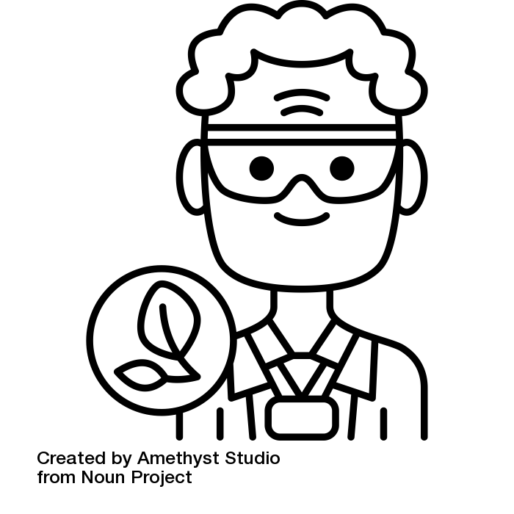
Why RDM is important - for you
Eligibility for financing
Saves time, nerves and resources
Facilitates the induction of new employees
Enhances teamwork and collaborations
Helps meet formal and legal requirements
Helps to keep track of the project
Guaranteeing transparency, verifiability and reproducibility
Citations, citations, citations, …
Source: Modified from Assmann et al. 2022, Bobrov et al. 2021, Bres et al. 2022, Jacob et al. 2022,
Lindstädt et al. 2019 und Voigt et al. 2022 von ZB MED 2024, Illustration: “botanist“” by Amethyst Studio is licensed under CC BY 3.0
Notes:
Slide content:
Certain funding sources (e.g. Horizon Europe) are only available to projects that draw up a data management plan.
Any additional funding conditions relating to the handling of research data are already covered by a professional DMP.
Duplication of work (e.g. having to spend time familiarising oneself with the data again) is avoided through appropriate documentation and preparation of the data.
If the data is requested during the review process, it is already prepared for this purpose through data management.
Many journals require publication
Professionally standardised FDM processes reduce the future effort involved in reusing the data, whether by the original researchers or by third parties.
The risk of data loss is minimised by FDM measures such as data documentation, data backup and suitable long-term archiving (LTA). Data can thus still be used decades later.

Slide 12
Research Data Life Cycle

Slide 13
What is the Research Data Life Cycle?
Model that illustrates the steps of research data management and describes how data should ideally flow through a research project to ensure successful data curation and preservation.
Sources: Nanyang Technological University and Princeton Research Data Service modified by ZB MED 2023; Illustration “definition” by Dewi Novita Sari is licensed under CC BY 3.0
Notes:
This slide is recommended if exercise 01-03-02-01, 'Sorting the Steps of the RD Lifecycle', follows it. Therefore, the cycle itself is not shown on this slide.
Slide content: Research Data Life Cycle definition

Slide 14
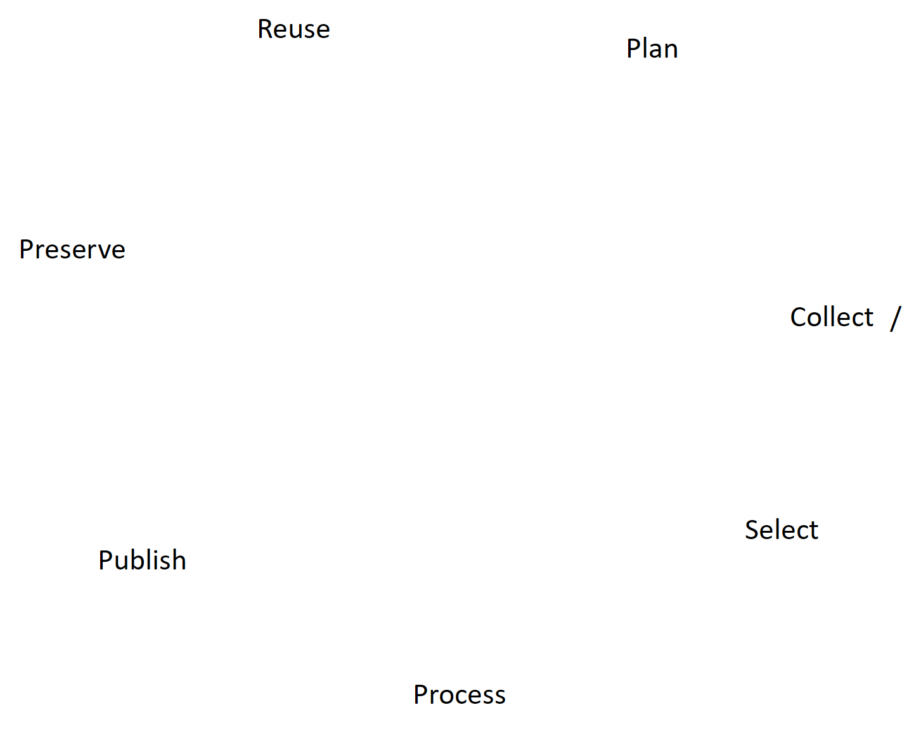

Research Data Life Cycle
Illustration: Elixir’s RDMkit is licensed under CC BY 4.0
Notes:
Slide content: the research data life cycle with all it’s steps

Slide 15

Data life cycle
Before implementation
Planning of all further steps incl. financial, legal,
ethical aspects DMP
<Foliennummer>
Source: Elixir’s RDMkit is licensed under CC BY 4.0
Notes:
Slide content:
Data management planning consists of defining the strategy that you plan to use for managing data and documentation generated within the project. It is about thinking upfront what’s the best way to avoid problems or unexpected costs related to data management, and set the conditions for your research data to achieve the highest possible impact in science, even after the end of the project. (from https://rdmkit.elixir-europe.org/planning).
Explain why is it important, what to consider for the planning, which tools can help (to create a DMP, por example). There is plenty information in the rdmkit site from Elixir.

Slide 16
Data life cycle
Before implementation
Planning of all further steps incl. financial, legal,
ethical aspects DMP
Active project phase
Identification of previous existing data
Storage and backup
Data organization
Documentation
Security and access
<Foliennummer>
Source: Elixir’s RDMkit is licensed under CC BY 4.0
Notes:
Slide content:
Data analysis consists in exploring the collected data to begin understanding the messages contained in a dataset and/or in applying mathematical formula (or models) to identify relationships between variables. Because of the relevance of the data analysis stage in research findings, it is essential that the analysis workflow applied to a dataset complies with the FAIR principles. Moreover, it is extremely important that the analysis workflow is reproducible by other researchers and scientists (from https://rdmkit.elixir-europe.org/analysing)
Data preservation consists of a series of activities necessary to ensure safety, integrity and accessibility of data for as long as necessary, even decades. Is important to make aware of how important Data preservation is (from https://rdmkit.elixir-europe.org/preserving)
Data sharing means making your data known to other people. It’s important to know that data sharing doesn’t mean open data or public data. Being able to easily share data makes research more efficient (from https://rdmkit.elixir-europe.org/sharing)
Reusing Data means using data for other purposes than it was originally collected for. Reuse of data is particularly important in science, as it allows different researchers to analyse and publish findings based on the same data independently of one another. Reusability is one key component of the FAIR principles. (from https://rdmkit.elixir-europe.org/reusing)

Slide 17
Data life cycle
Before implementation
Planning of all further steps incl. financial, legal,
ethical aspects DMP
Postproductive phase
Data publication
Repositories
Licenses
Metadata
Archiving
Active project phase
Identification of previous existing data
Storage and backup
Data organization
Documentation
Security and access
<Foliennummer>
Source: Elixir’s RDMkit is licensed under CC BY 4.0
Notes:
Slide content:
Data analysis consists in exploring the collected data to begin understanding the messages contained in a dataset and/or in applying mathematical formula (or models) to identify relationships between variables. Because of the relevance of the data analysis stage in research findings, it is essential that the analysis workflow applied to a dataset complies with the FAIR principles. Moreover, it is extremely important that the analysis workflow is reproducible by other researchers and scientists (from https://rdmkit.elixir-europe.org/analysing)
Data preservation consists of a series of activities necessary to ensure safety, integrity and accessibility of data for as long as necessary, even decades. Is important to make aware of how important Data preservation is (from https://rdmkit.elixir-europe.org/preserving)
Data sharing means making your data known to other people. It’s important to know that data sharing doesn’t mean open data or public data. Being able to easily share data makes research more efficient (from https://rdmkit.elixir-europe.org/sharing)
Reusing Data means using data for other purposes than it was originally collected for. Reuse of data is particularly important in science, as it allows different researchers to analyse and publish findings based on the same data independently of one another. Reusability is one key component of the FAIR principles. (from https://rdmkit.elixir-europe.org/reusing)

Slide 18


Icebreaker
Please note down
Your Name
The Datatype you are working with
When it’s your turn
Pin it to the stage of the Lifecycle, you are in at the moment

